Slide 1
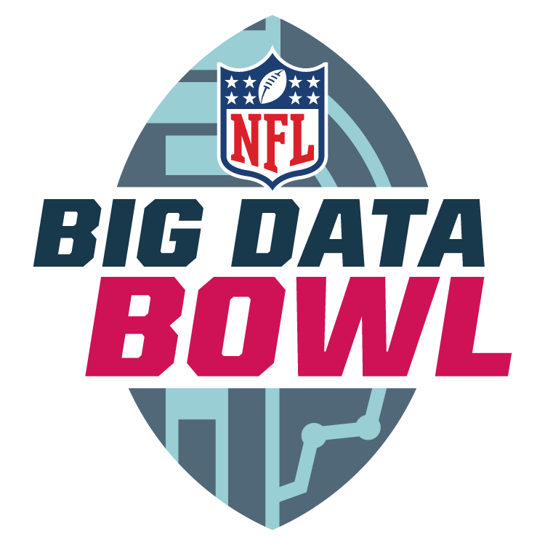

Bayesian Classification for NFL Defensive Coverages
Matt Manner, Connor Nickol, Josh Gen

Slide 2
Background
NFL’s yearly Big Data Bowl analytics competition
NFL releases Amazon Web Services (AWS) Next Gen Stats player tracking data
Our data: first 8 weeks of 2021 season
Included data sets:
Players: name, unique ID, position for 1679 players
Plays: unique play ID, offensive/defensive team, pass coverage for 8557 plays
PFF: player, play, position for 188254 player-plays
Games: 10x/sec player & football location tracking data for each play
Goal: predict defensive coverages from defensive player alignment pre-snap
Motivation: thousands of man-hours spent analyzing film for multi-billion dollar industry
Want appropriate uncertainty measures for this classification problem

Slide 3
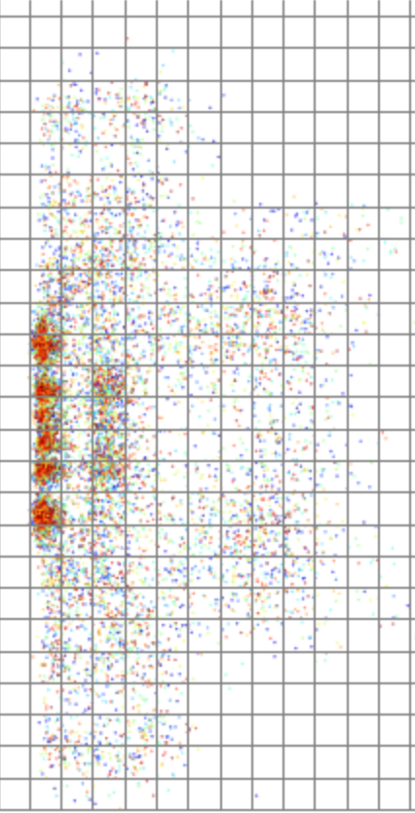
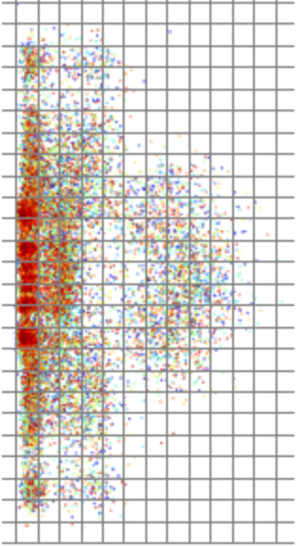
Data Processing
Defensive players only
Only consider player locations at moment ball is snapped
Use football location data to code player locations
Want player locations relative to the ball, rather than absolute position on field
Ball is always (0,0) for each play
Transform location data from coordinates to numbered “box” system covering the useful playing field (sideline to sideline, line of scrimmage to 26 yards deep)
Each box used as a predictor variable, where value = number of players in box before snap
COVER 2 (n = 944)
COVER 1 (n = 1759)

Slide 4
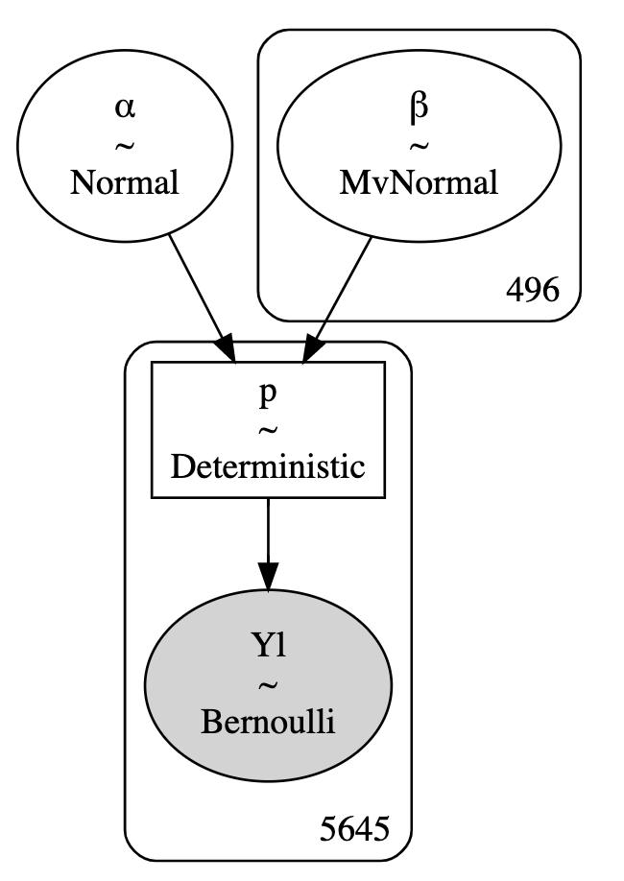
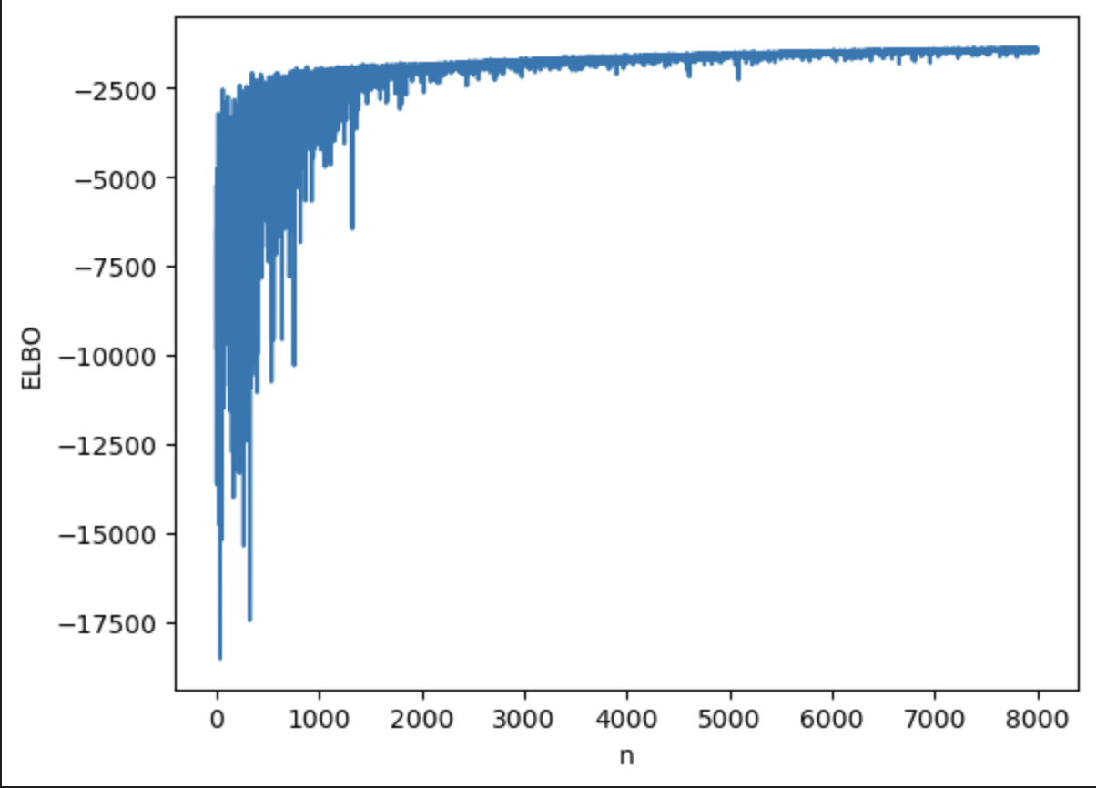
Methodology
Approx. 7800 observations (plays) and 496 predictors (field grids)
Sparse matrix: only 11 defensive players allowed per play so most field grids are empty
Response variable is coverage type (7 levels)
One-hot encoded to enable 7 one vs. rest Bayesian logistic regressions
Posterior for logistic regression coefficients obtained via Variational Inference
Computationally intractable, large data set
COVER 5 regression ELBO plot
Code Reference for posterior prediction: https://juanitorduz.github.io/sklearn_pymc_classifier/

Slide 5
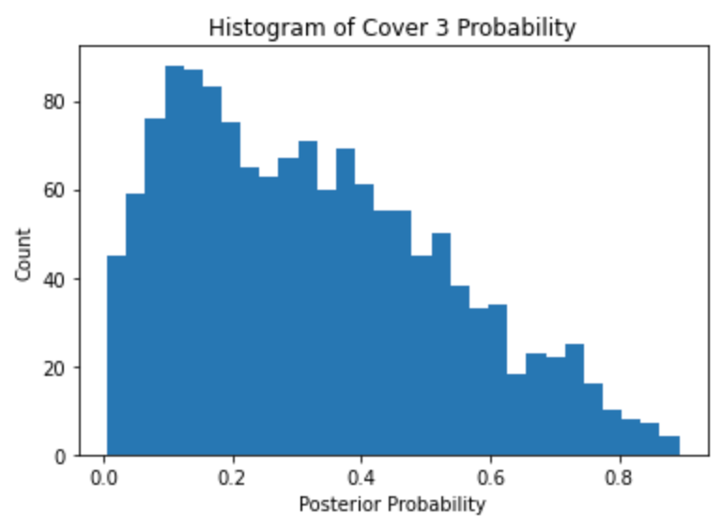
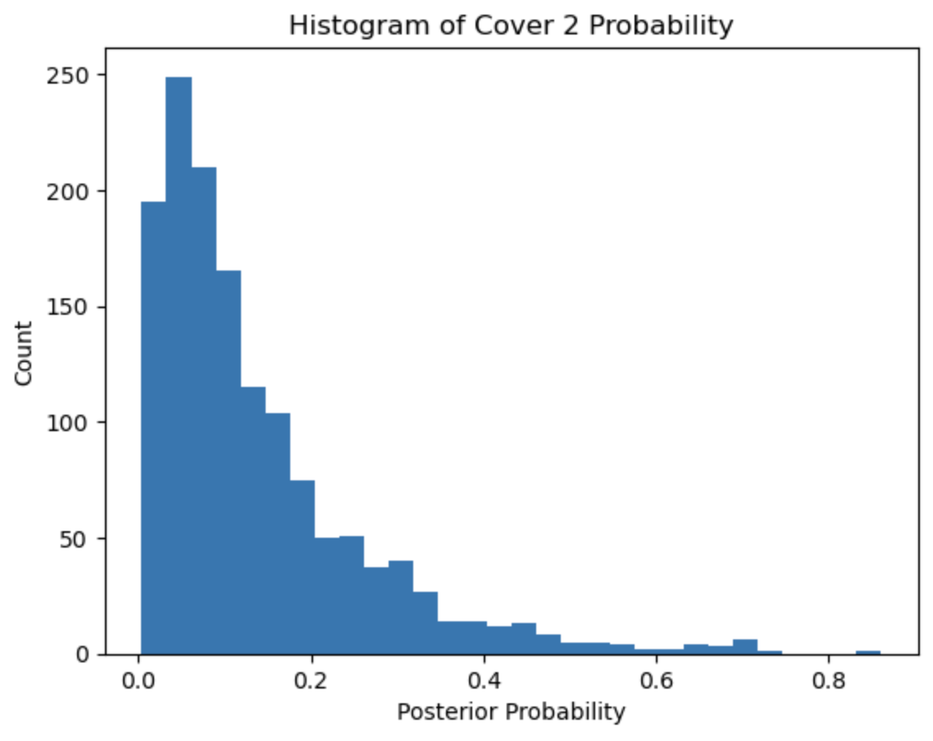
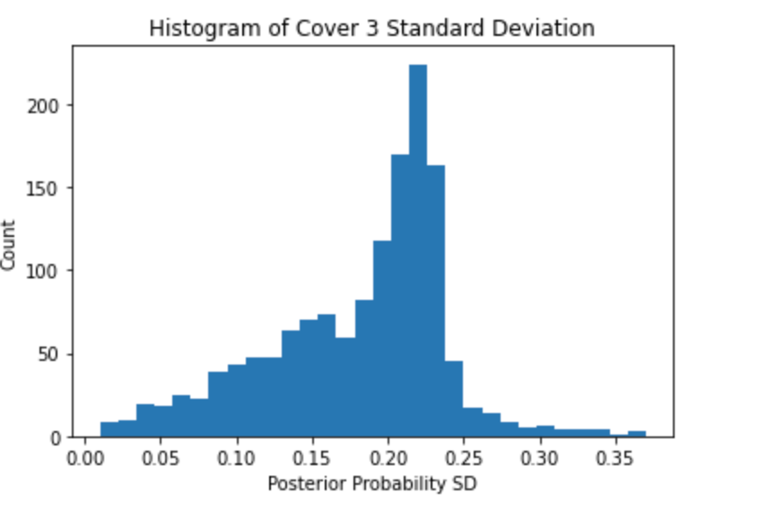
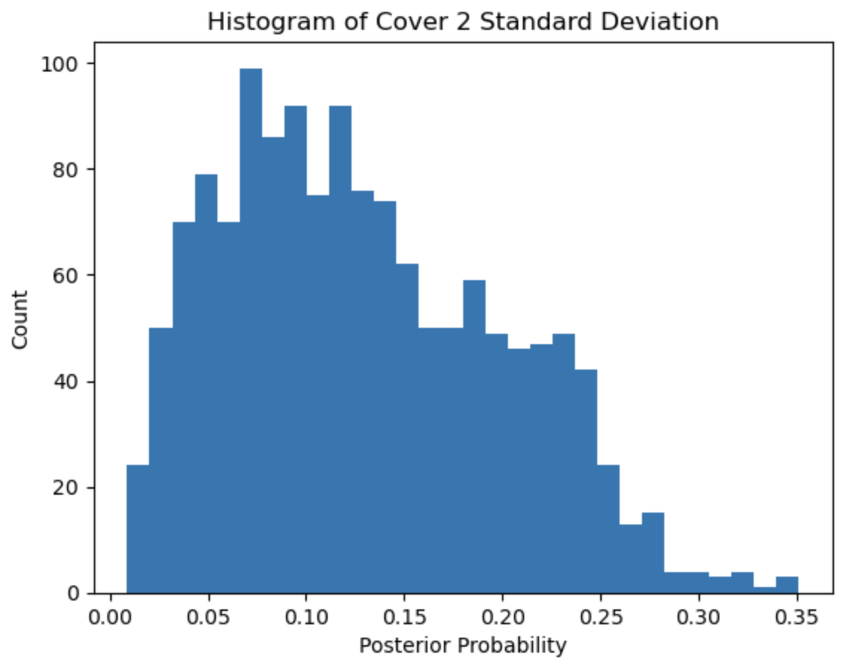
Results/Output
Calculated 94% credible interval for each coverage probability for each sampled play
Gauged accuracy by choosing Bayes optimal coverage (maximum probability)
Accuracy: 47.03% vs. 14.29% from random guessing (1/7) vs. 33.2% from always guessing Cover 3
Cover 3
Cover 2

Slide 6
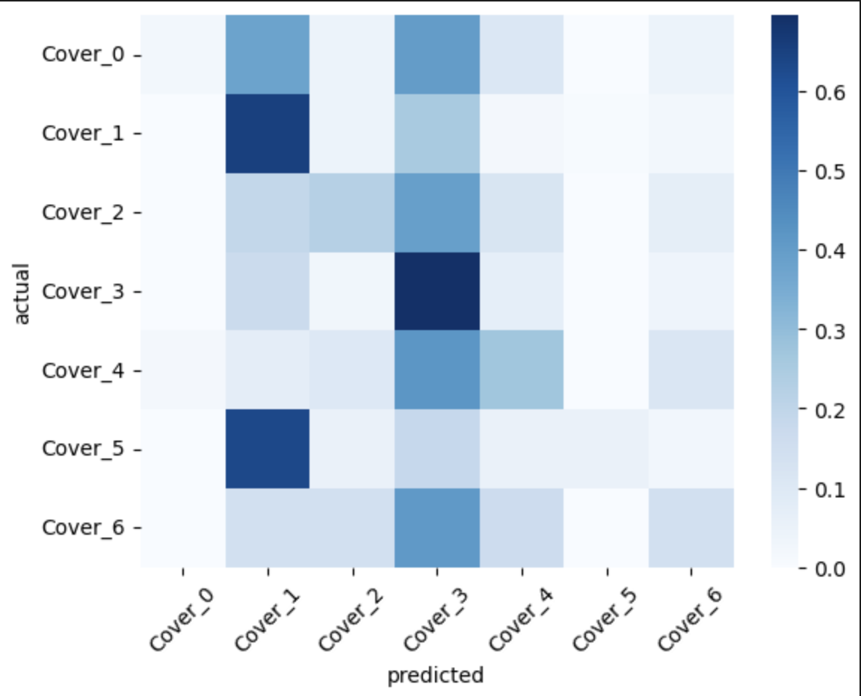
Conclusion
Certain coverages are more difficult to predict with pre-snap positioning
Cover 1 and Cover 3 by far most commonly predicted coverages
This is intentional - NFL teams attempt to disguise coverages to confuse offense
Incorporating post-snap player movement would likely improve model
Needs to achieve significant improvement in accuracy to replace manual film study
Average Predicted Coverage Probability by Actual Coverage
Actual Coverage
Perfectly performing model would show identity matrix
Predicted Coverage

